Slide 1
Do Space Innovation Fellowship
By Charlie Cuddy with Bricklayer

Slide 2
The Goal of Innovation Fellowship:
My focus is to help get computer programming into more classrooms, libraries, and after school programs by giving teachers a guide on how to easily use Bricklayer in their classroom without the teacher needing to have previous knowledge themselves.
Bricklayer is a local non-profit which combines the use of code, math, art, spatial recognition, creativity, and problem-solving to teach computer science.

Slide 3
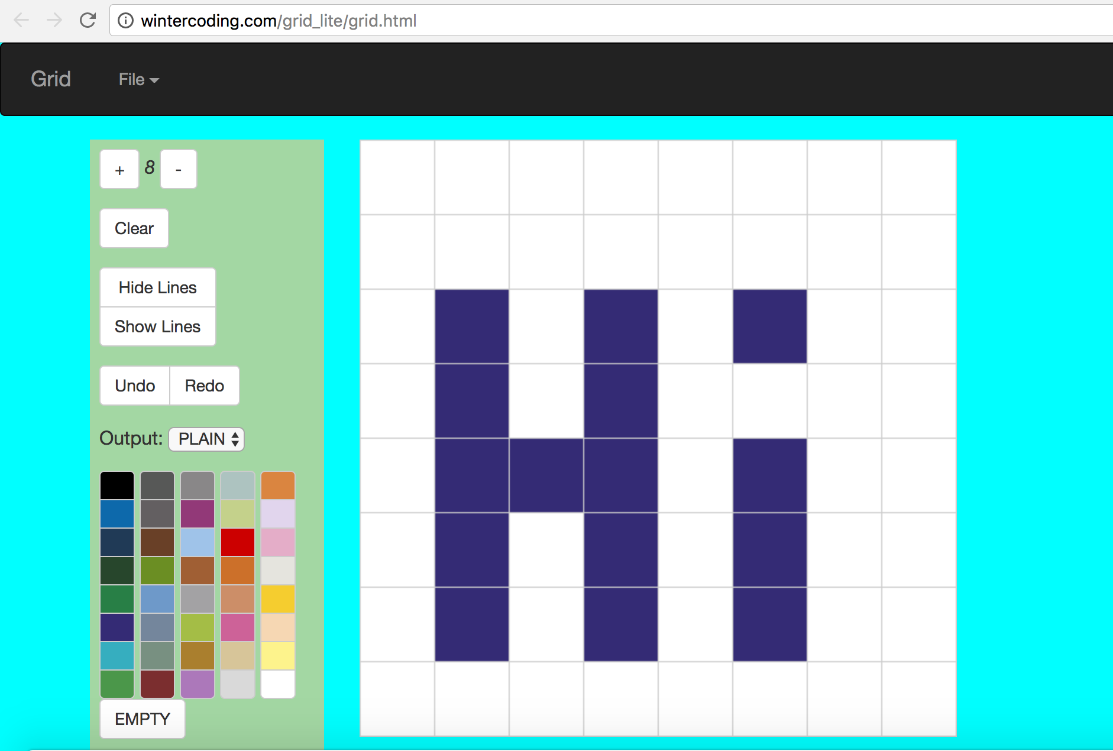
First Sessions with Bricklayer: The Grid

Slide 4
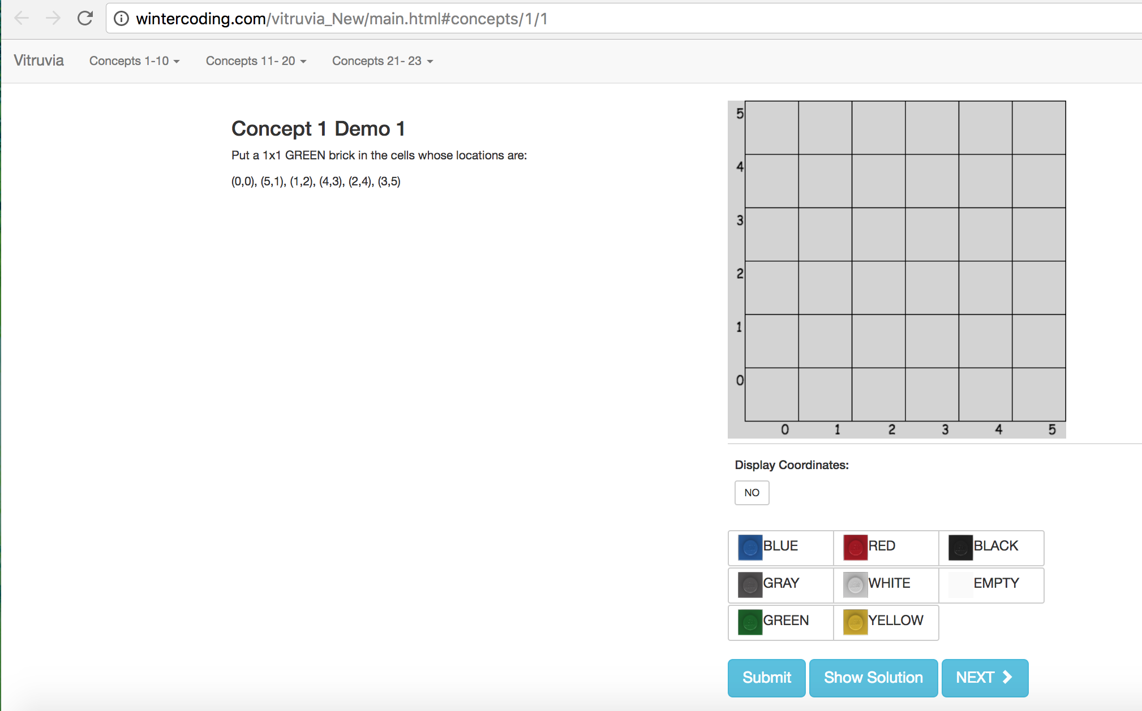
First Sessions with Bricklayer: Vitruvia

Slide 5
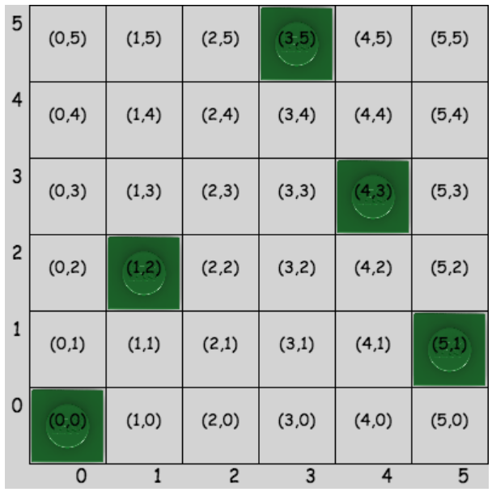
First Sessions with Bricklayer: Vitruvia

Slide 6
First Sessions with Bricklayer: Bricklayer-Lite

Slide 7
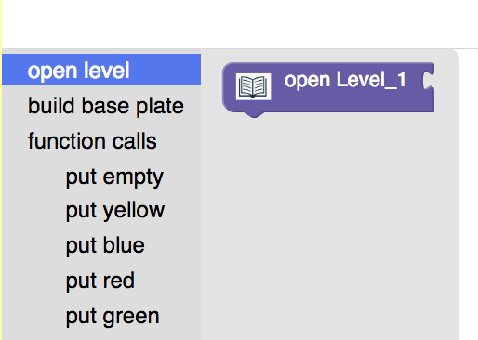
Drag and Drop Code Blocks

Slide 8
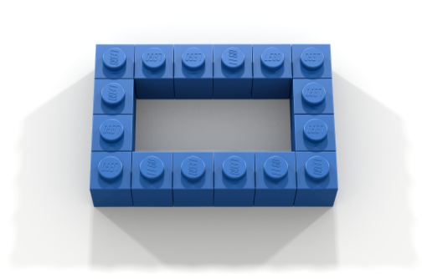
Exercises to Practice Bricklayer-Lite

Slide 9
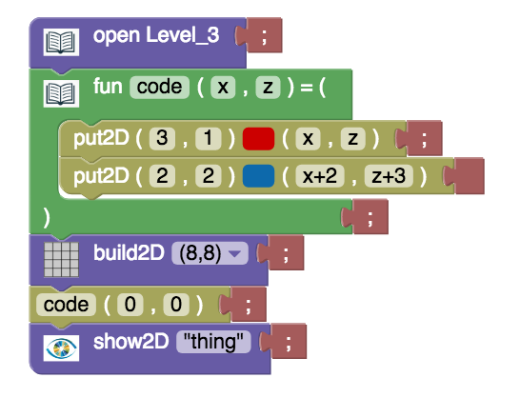
Bricklayer
open Level_3;
fun code(x,z) = (
code;
the;
thing
);
build(8,8);
code(0,0);
show “thing”;

Slide 10
Bricklayer
All exercises done in Bricklayer-Lite can be coded in Bricklayer with the same format
Video Tutorials and Code-Alongs available at Bricklayer
Documentation available at Bricklayer

Slide 11
Beginner Bricklayer Projects

Slide 12
Exercises to Practice Bricklayer

Slide 13
Pentominoes

Slide 14
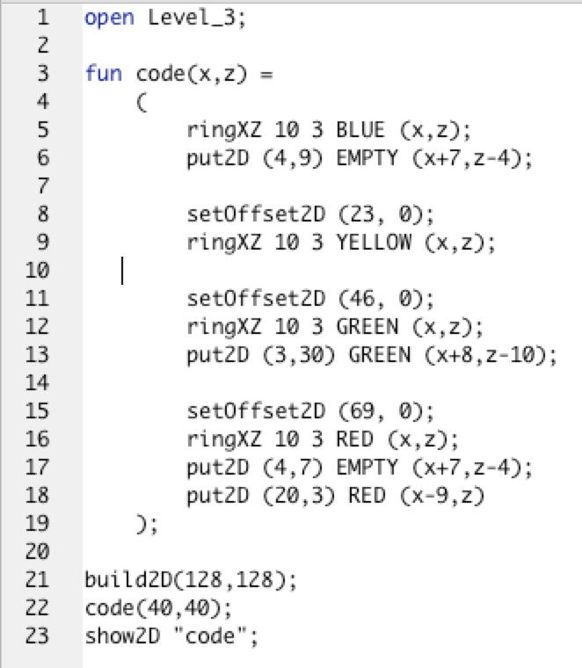
View in LDD

Slide 15
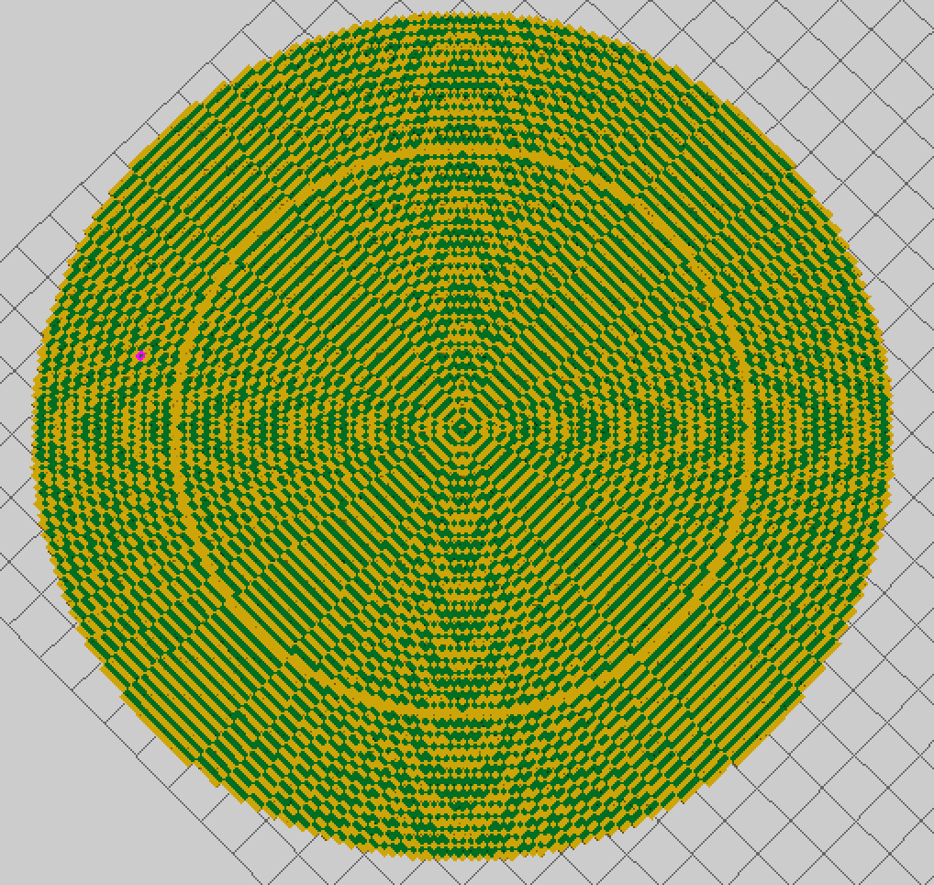
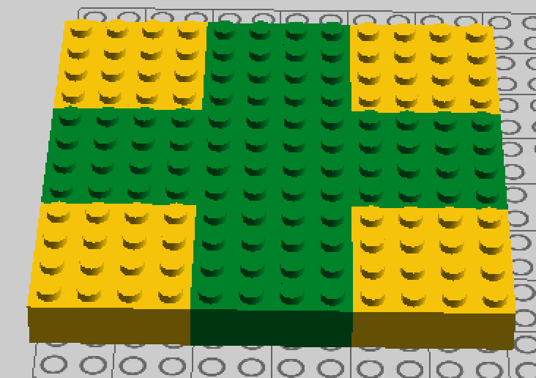
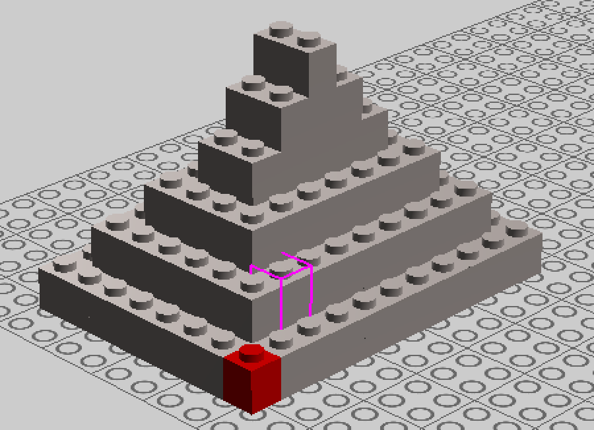

Slide 16
Moderate Bricklayer Projects

Slide 17
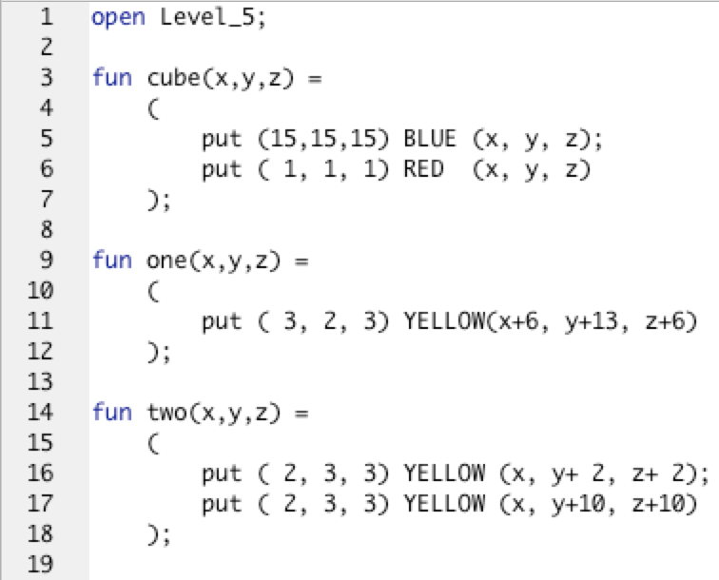
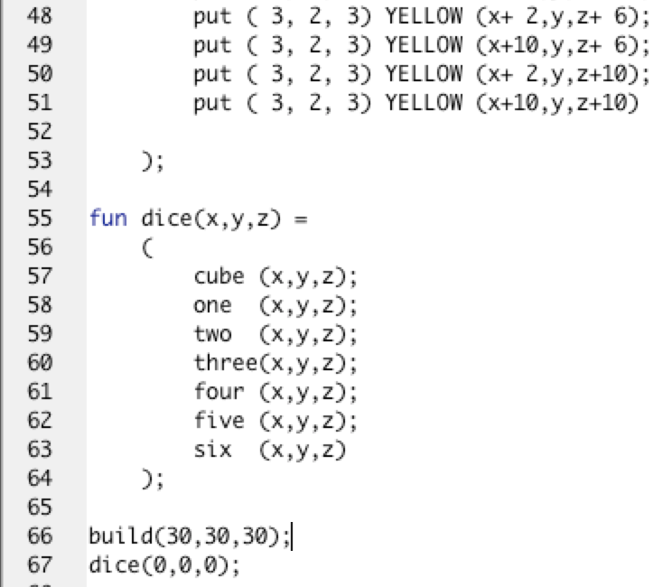
Code to DIE for…

Slide 18
View in LDraw

Slide 19
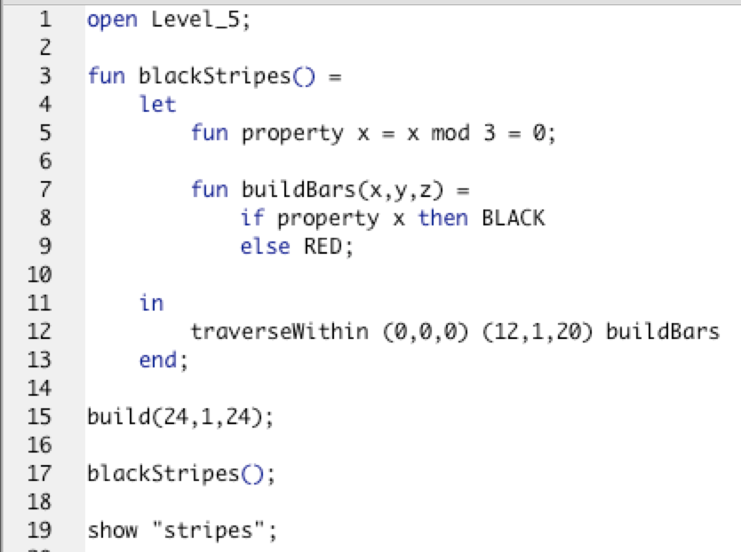
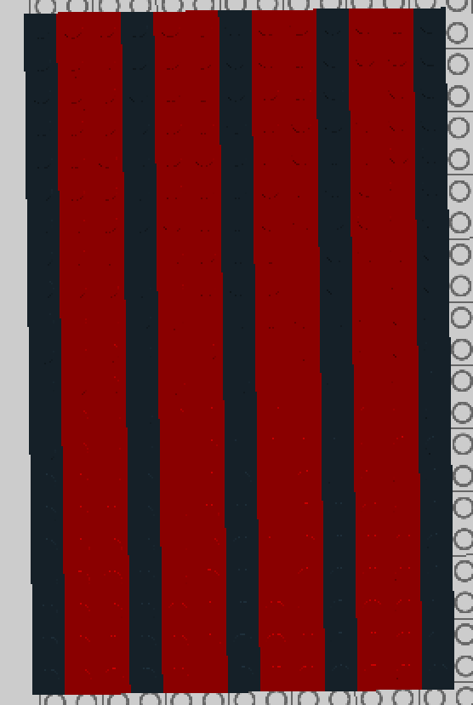

Slide 20
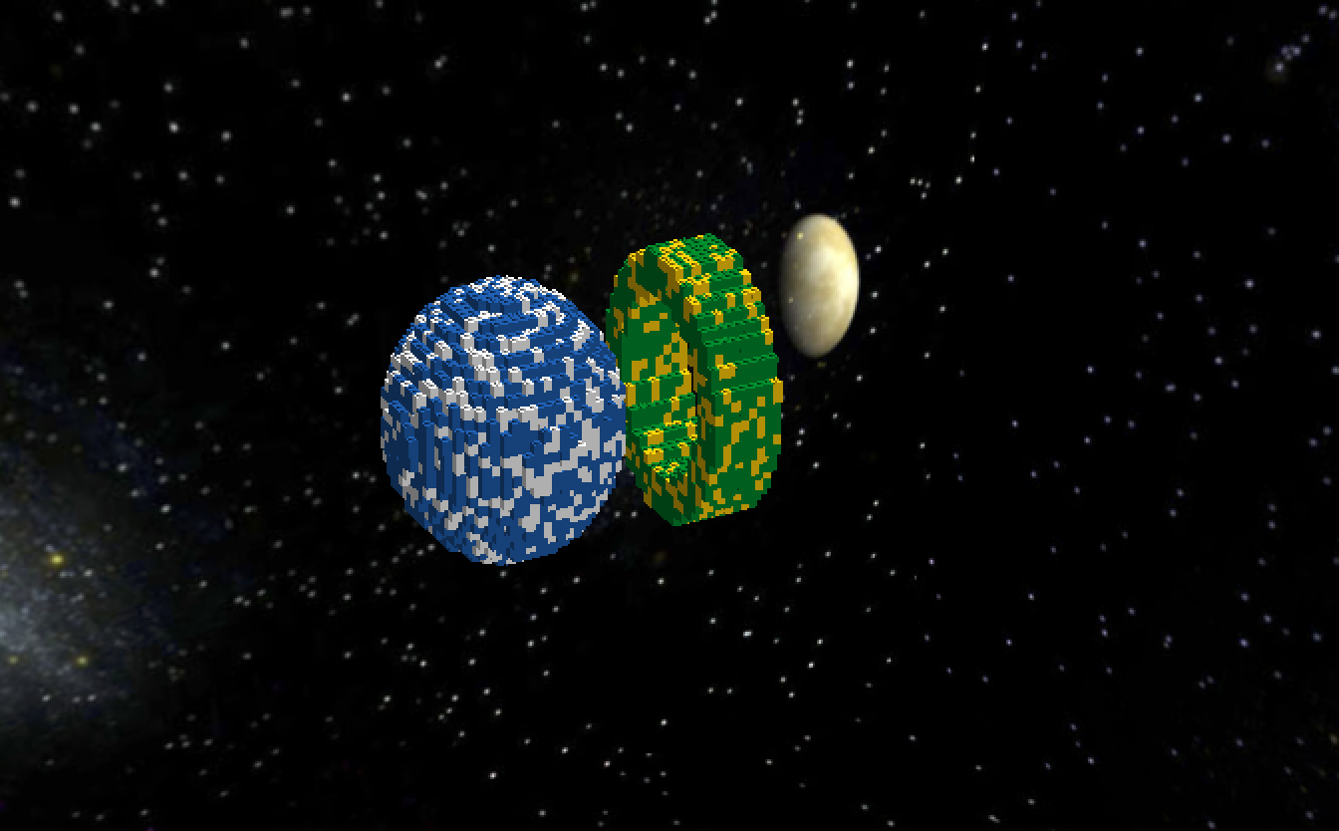
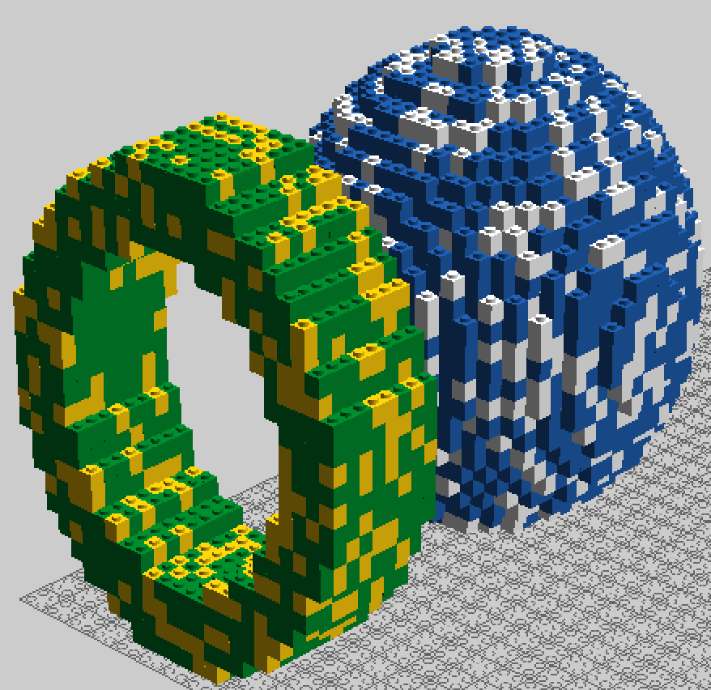
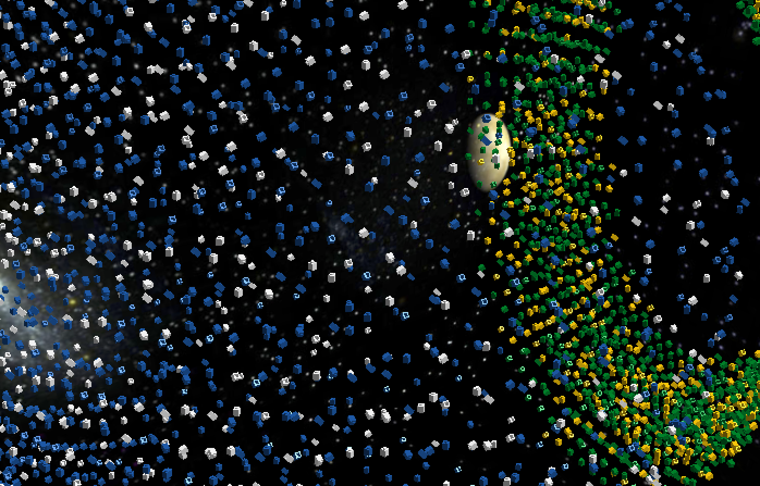

Slide 21
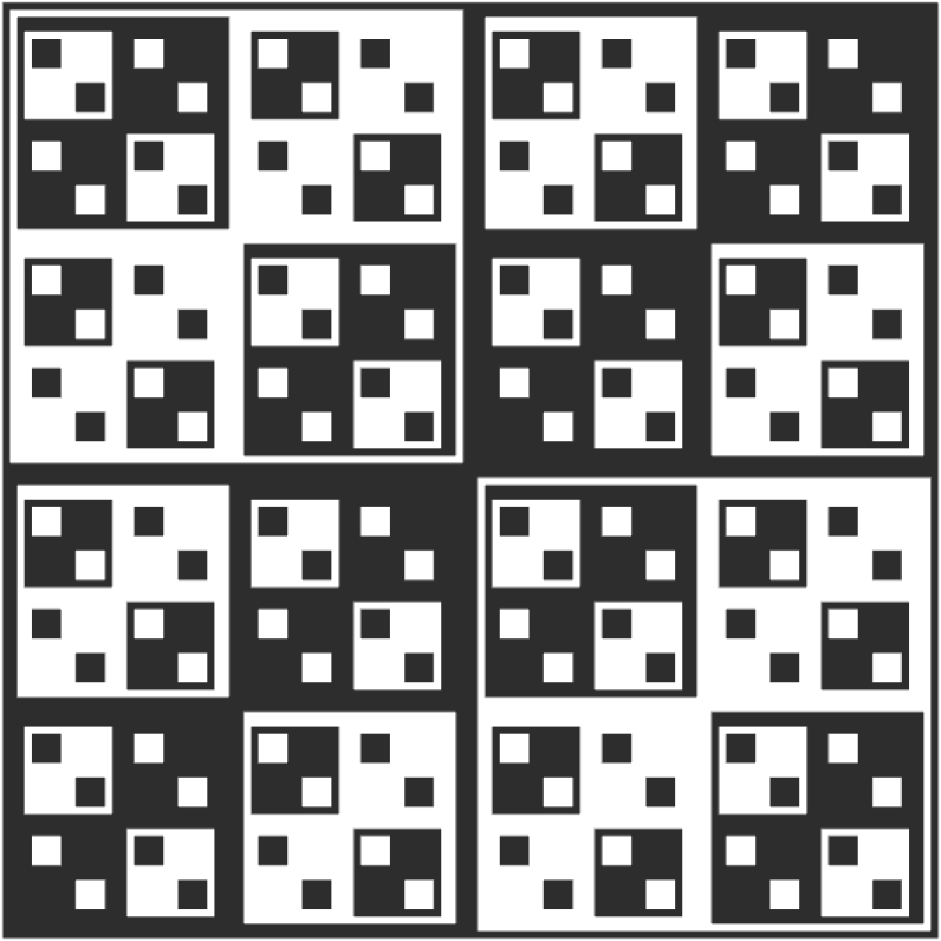
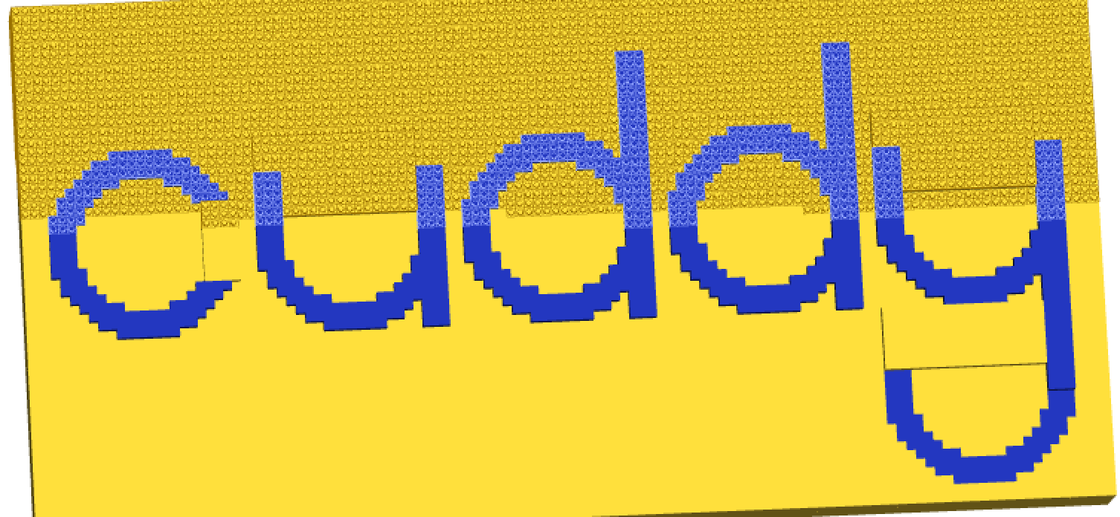

Slide 22
Advanced Bricklayer Projects

Slide 23
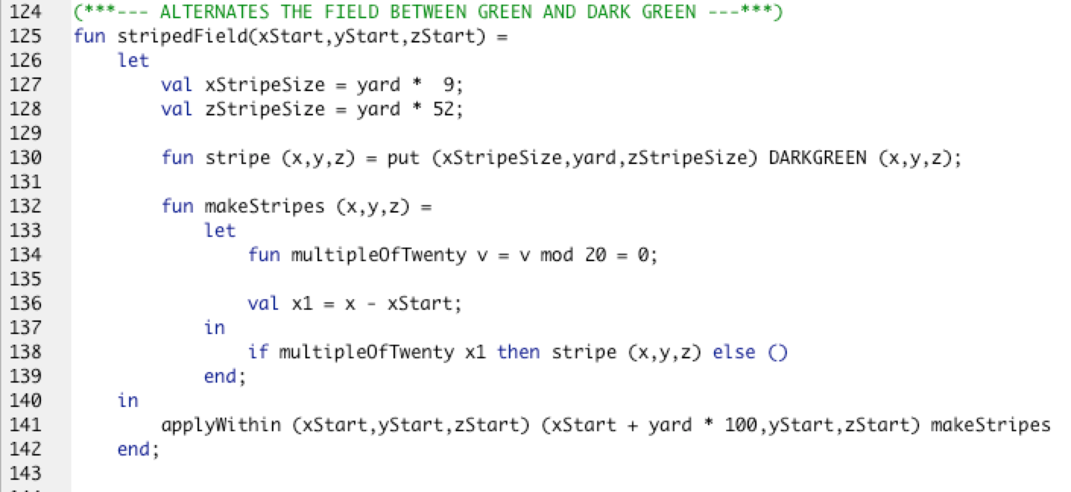
Memorial Stadium

Slide 24
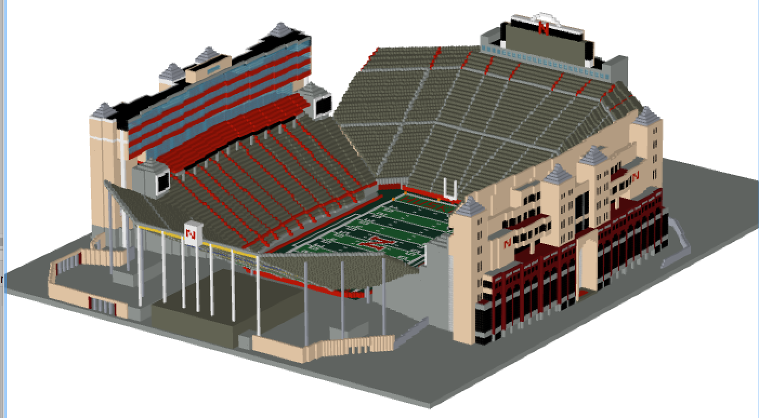

Slide 25
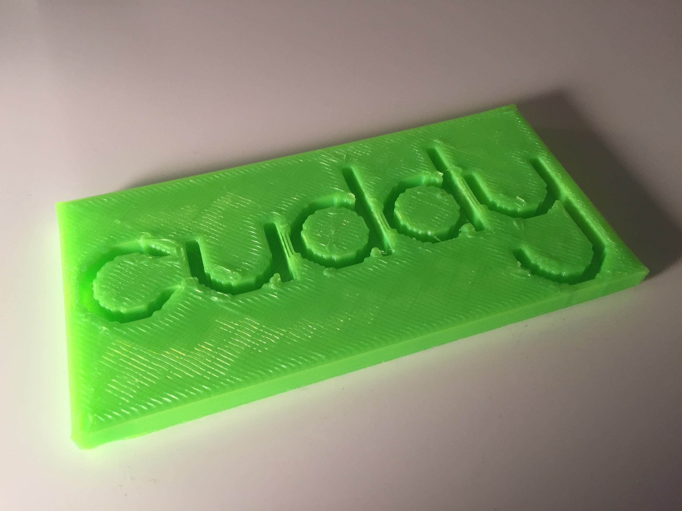
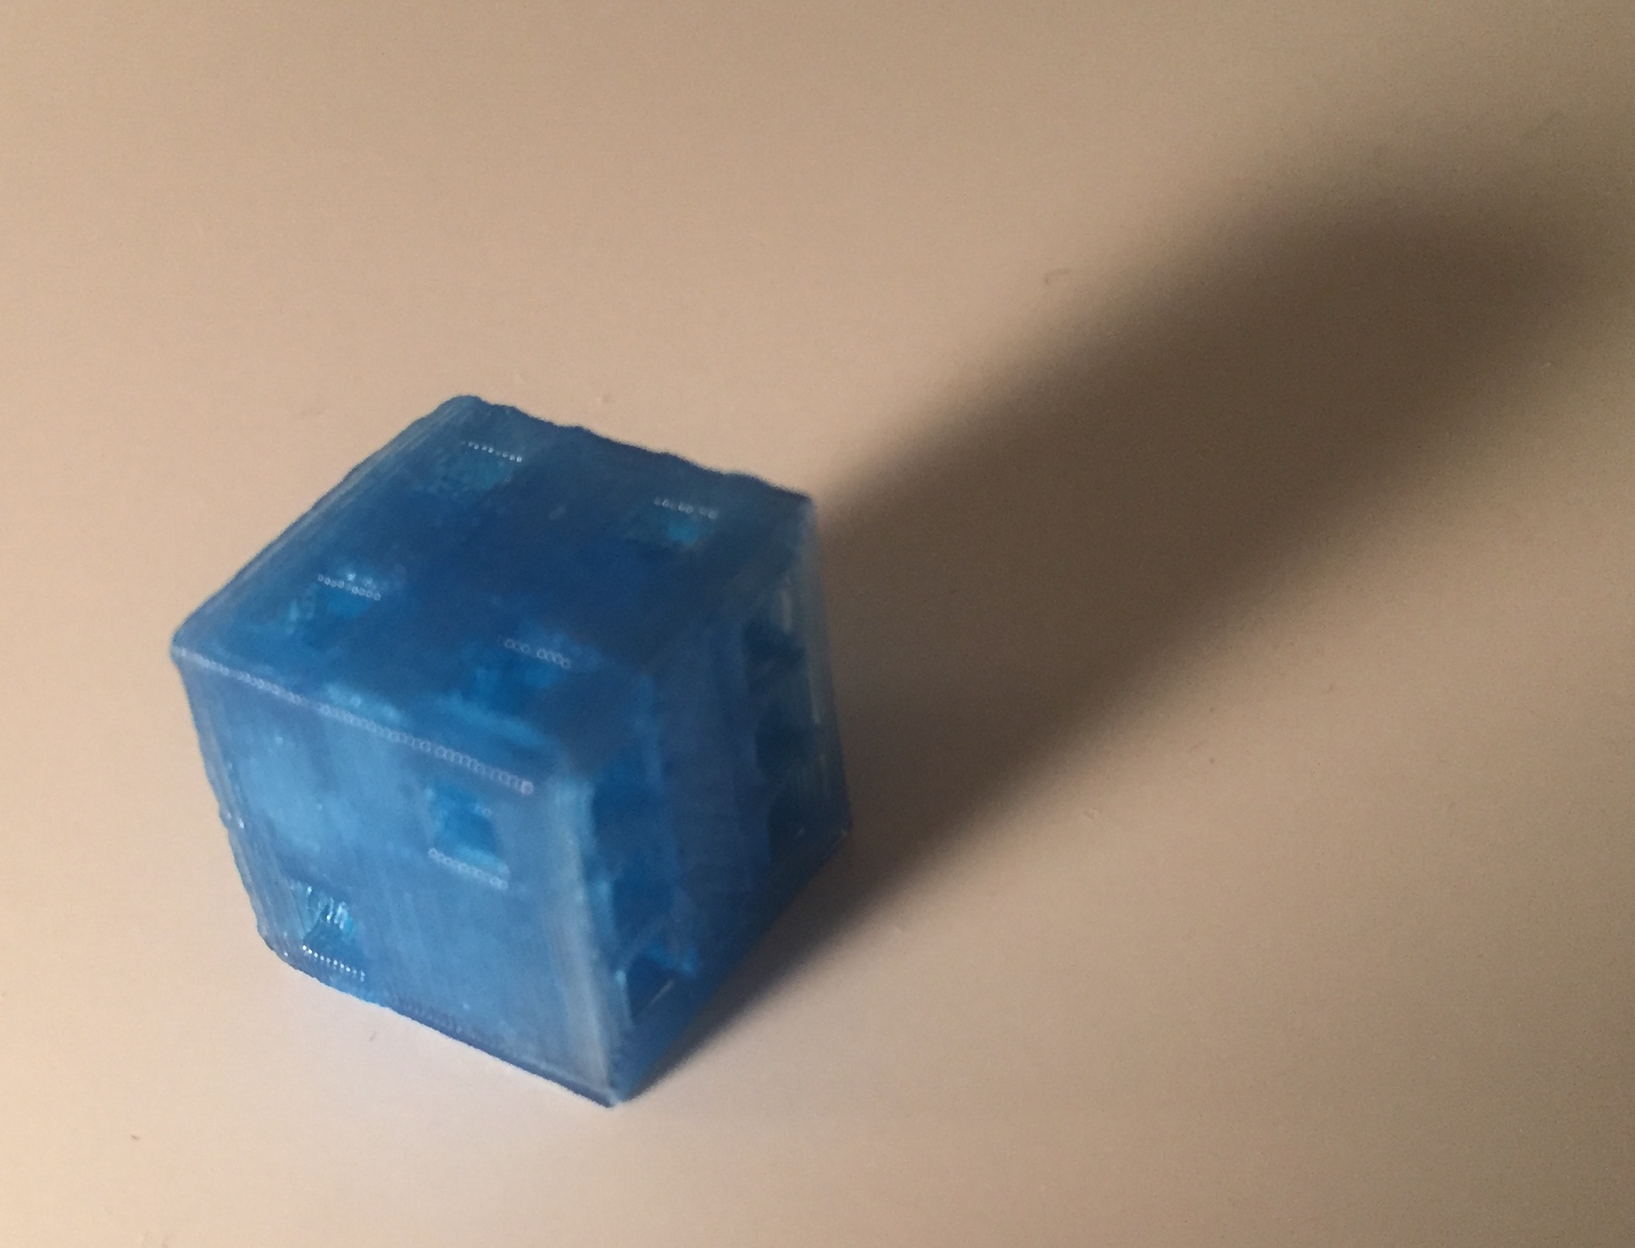
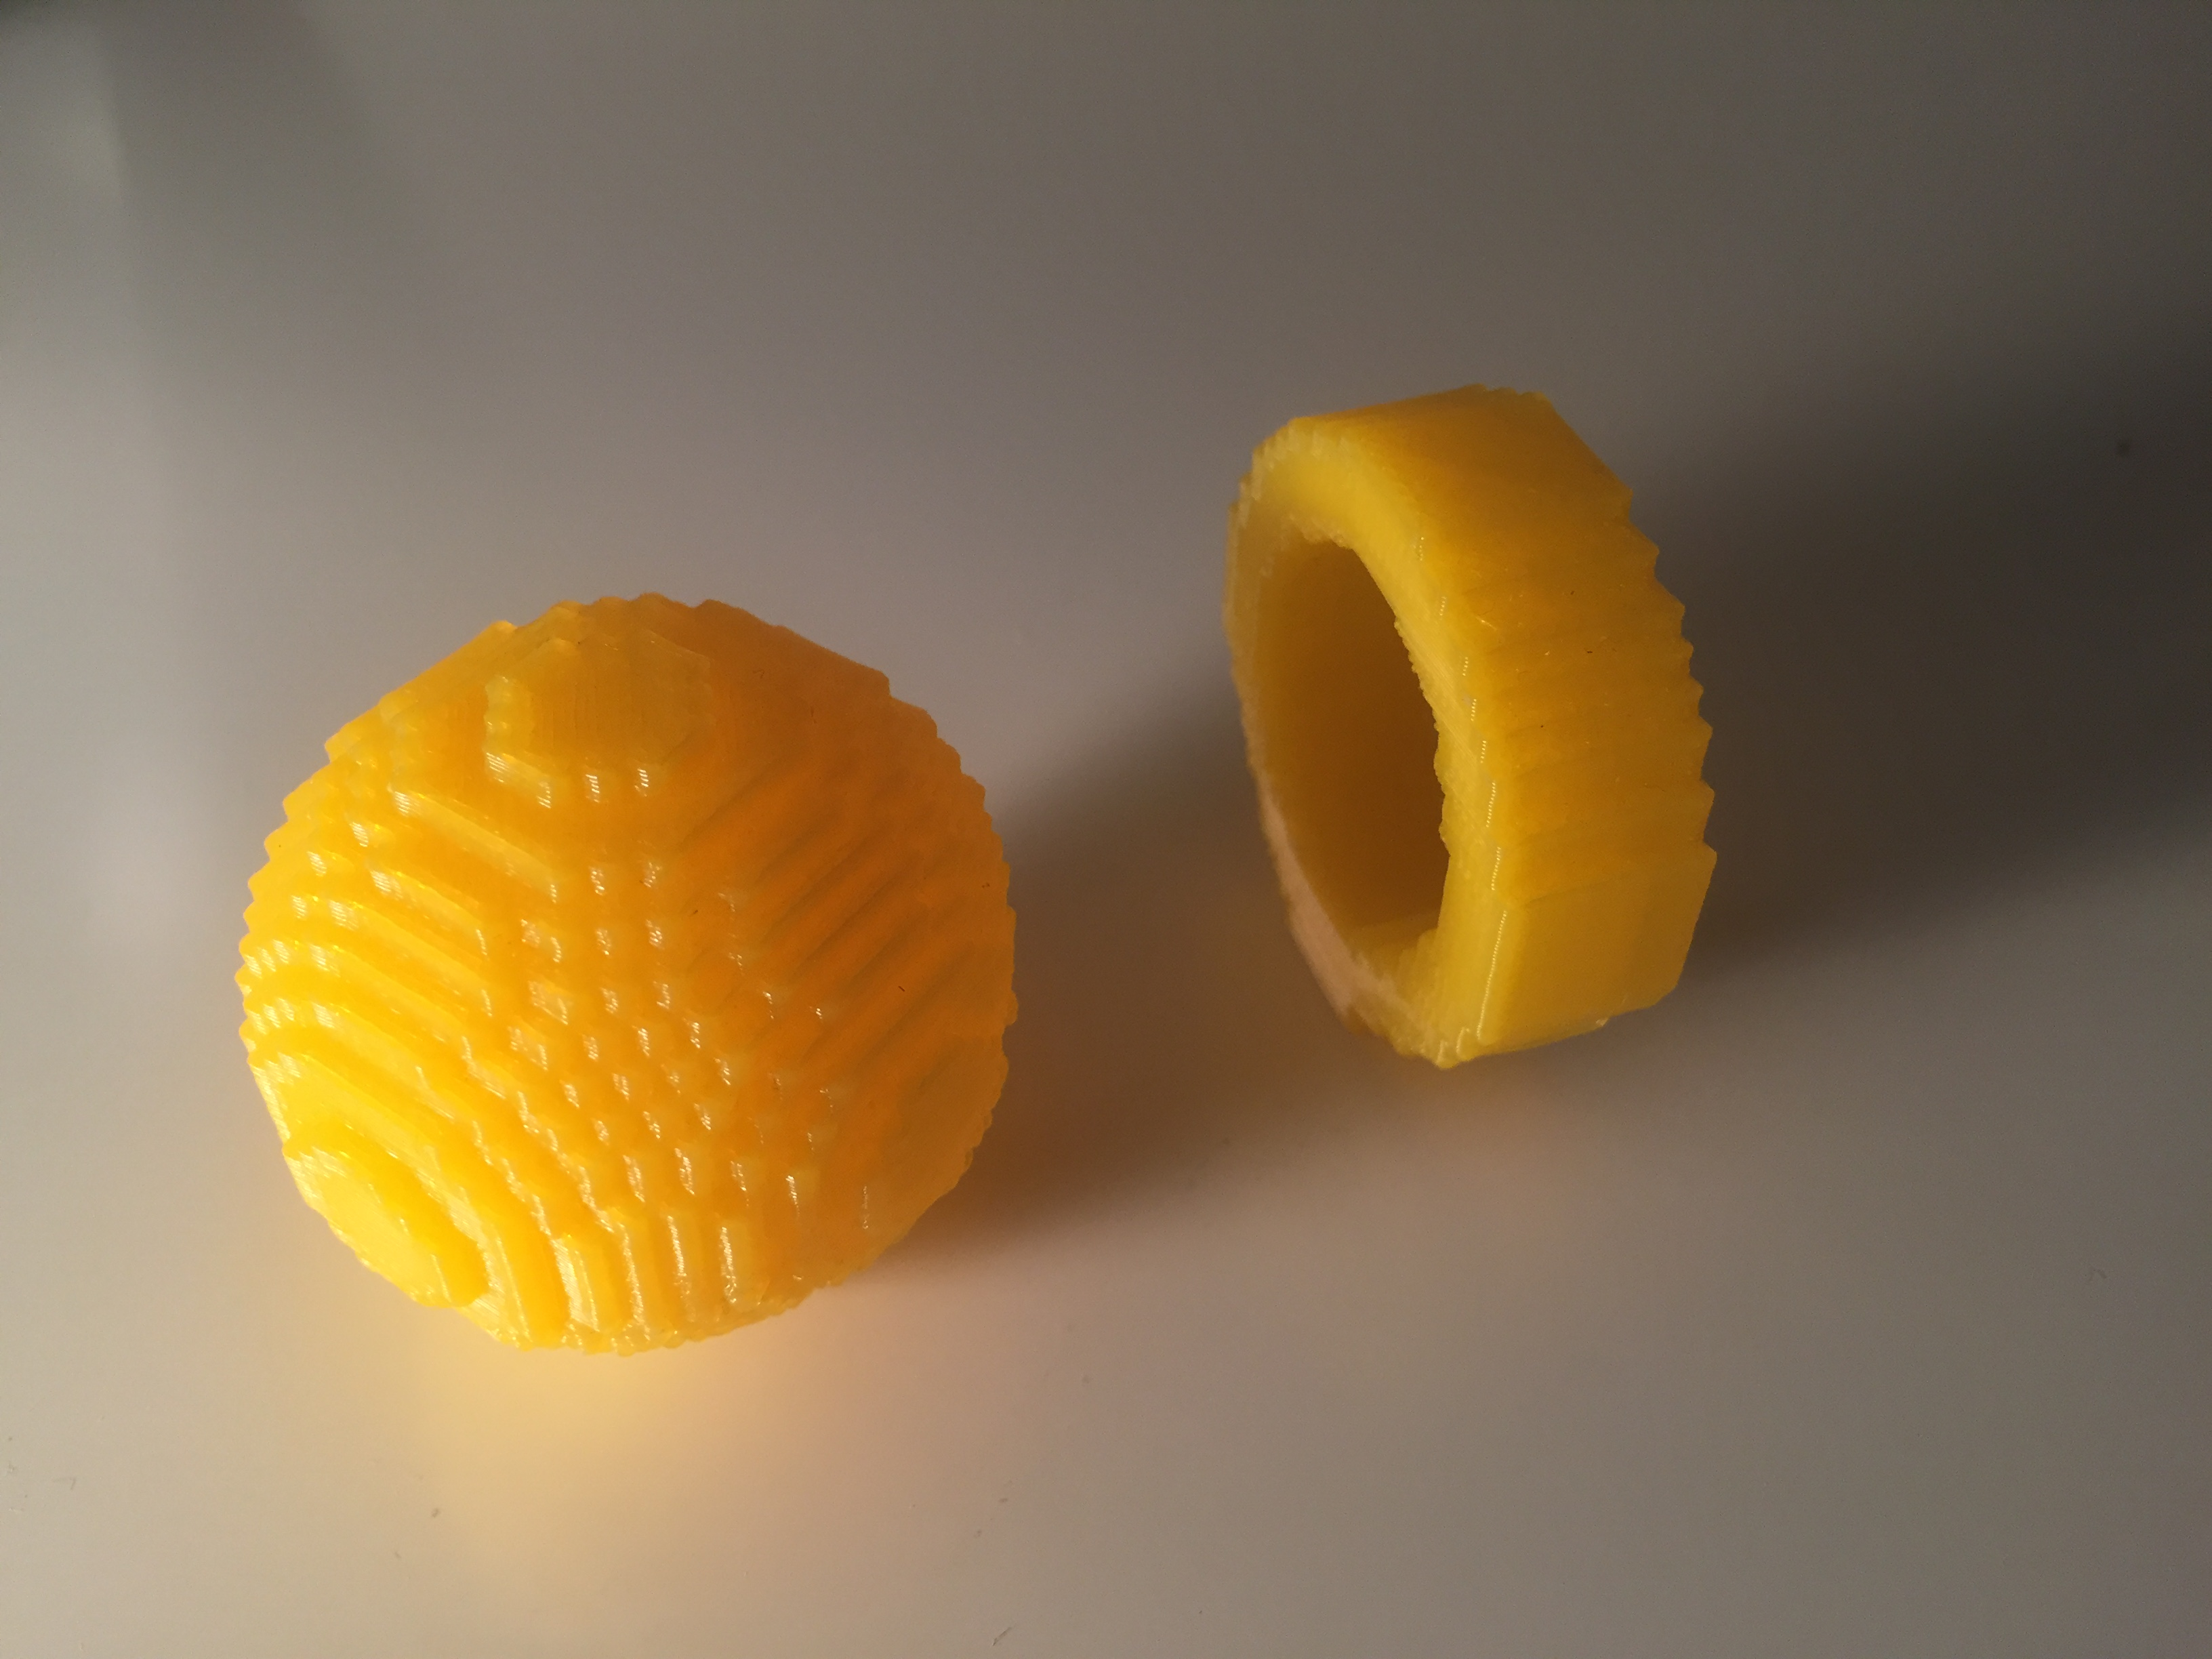

Slide 26
https://codecuddy.github.io/bricklayer/
This website was built to help set up the steps to get started in Bricklayer, exercises to practice coding in Bricklayer, and ideas of artifacts to code.

